Slide 1
AFFIRMATION
I am a radiant expression of the Eternal Reality actualizing the Divine Life,
a world of love, wisdom, and fulfillment
Notes:
all beings are on a path back to realizing their original, divine nature while simultaneously expressing that divinity uniquely in the world of form. It is not only about Revealing our True Nature, but also about expressing it in our cherished, unique manner.

Slide 2
Meditation
Music
Elgar’s “Enigma Variations”
Variation #9 “Nimrod”
Notes:
Bernstein’s performance is about the deep meaning of every moment and …

Slide 3
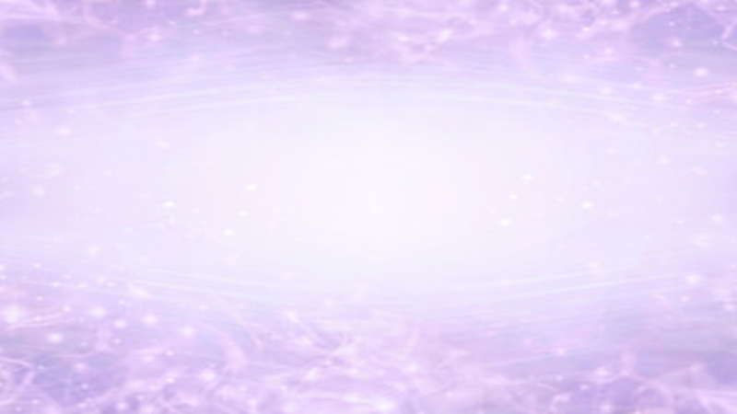
The Jewel in the Lotus
“Awakening the Finder in the Seeker” Celebrating the Divine Spark
David McClanahan

Slide 4
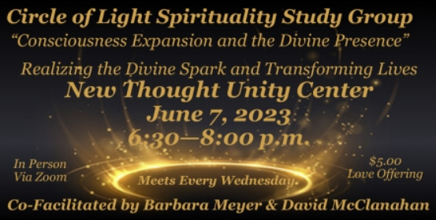

Slide 5
My next three books are:
Mysticism for the 21st Century
A translation and commentary on the classic mystic writings of Evelyn Underhill
Awakening Joyous Spirituality
Growing the Divine Spark into the Divine Flame
Includes metaphysics, diagrams of spiritual evolution, spiritual practices and the spiritual planes of creation and the Awakening Release techniques .. Etc.
The Fine Arts as a Spiritual Path
The Joy of Cultivating Experience
www.davidmcclanahan.com/unity

Slide 6
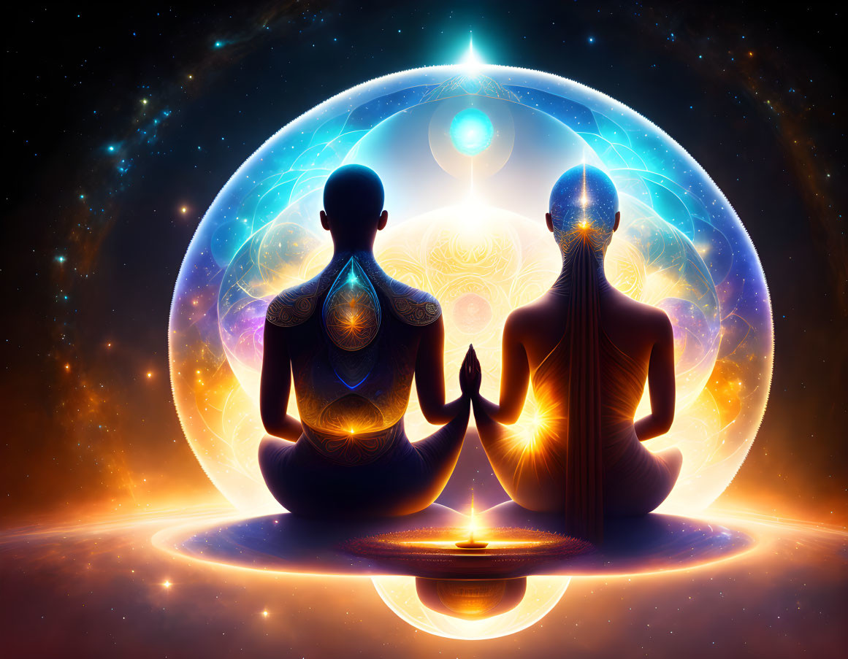
Notes:
Sharing our Life Experiences creates a synergy of Revelations and Miracles
[2nd reflection .. In Presence we “know” everything., Going further, in shared contemplation, we find new expressions that flow from the abstract to the particular. This allows the mind to connect with the Soul’s experience and actualize the “knowing” into Wisdom. We gain access to this wisdom in our “Person” , expanding consciousness by integrating (spiritual integration) the Spiritual into the Personal Life. ]]

Slide 7
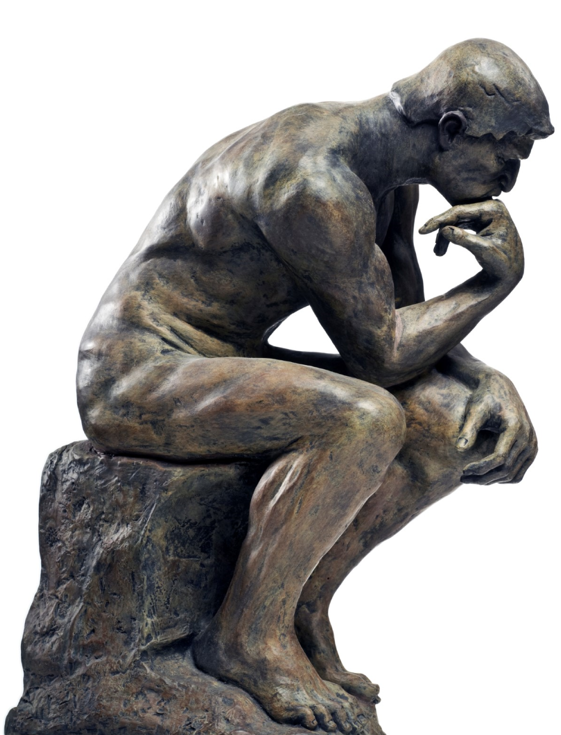
Notes:
The Western Approach to finding the meaning of life.

Slide 8
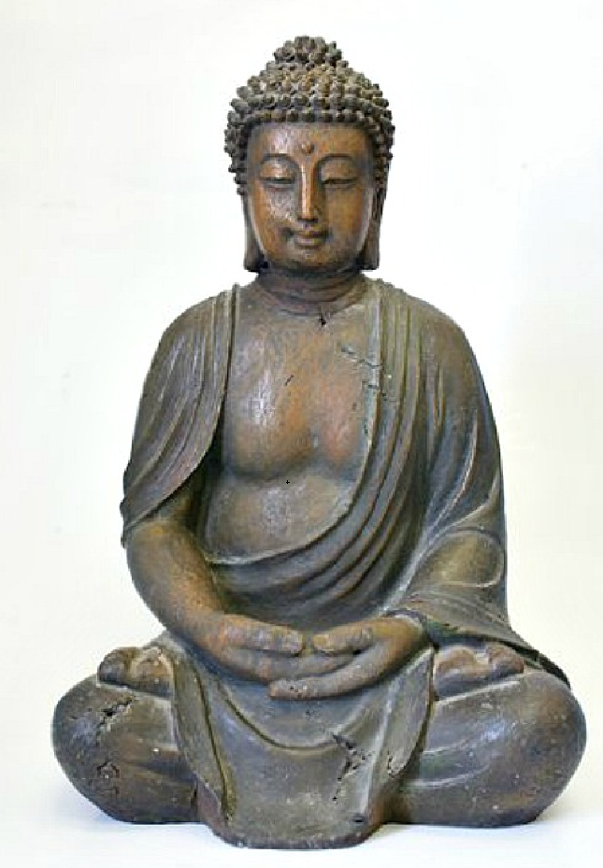
Notes:
The Eastern and Mystic Way

Slide 9
Notes:
Essemce. We are of the same essence as the Divine; Being, Consciousness and Bliss. In the East it is Sat-Chit-Ananda.

Slide 10
Notes:
Bliss is expressed as and in Love (All You Need Is Love)

Slide 11
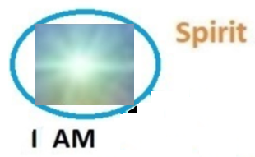
Notes:
The Absolute is the source of our essence. The Divine Spark has the same nature as the Divine. Sat Chit Ananda with the gift of uniqueness. (This is manifested in the Highest Spiritual Plane of Creation)

Slide 12
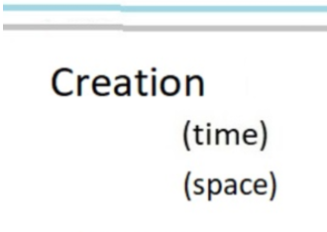
Notes:
The Divine Creator as a creative expression of Love creates the Cosmos, The universe. We (Divine Sparks) are invited to participate in the Divine Creation.

Slide 13
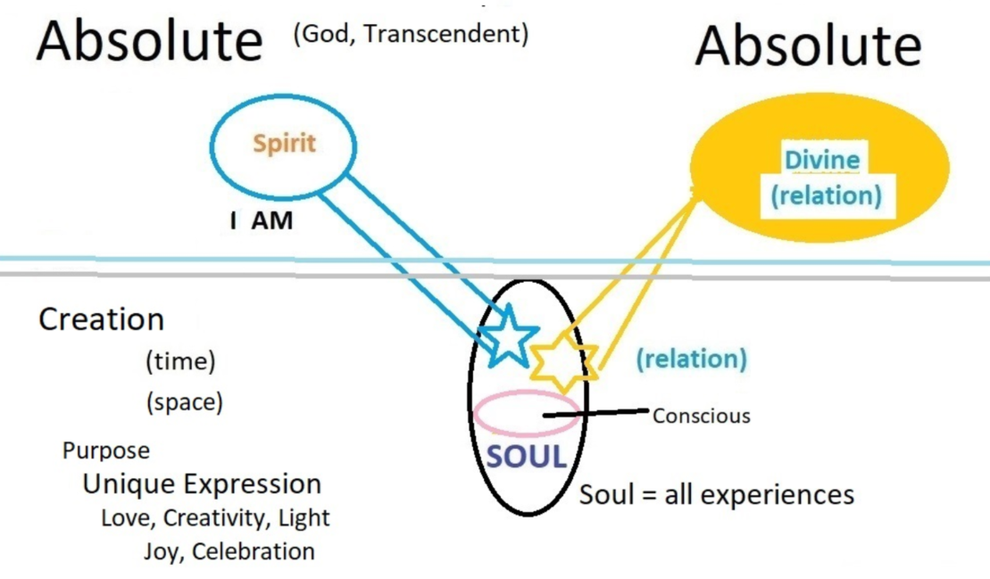
Notes:
Our essence is Spirit. To play a role in the Divine Creation we are given a soul (a spiritual body). As the divine spark enters creation, it is encapsulated within a soul, which is viewed as a distinct creation by the Divine, designed to house the spark within the manifest world. This soul is not just a repository of experiences, but a dynamic, evolving spiritual entity. It’s the vehicle through which the divine spark engages with the universe. ABOVE the two horizontal represents the Transcendental Absolute. Below the line represents the Divine Creation into which we are invited to take part as conscious co-creators with the Divine.

Slide 14
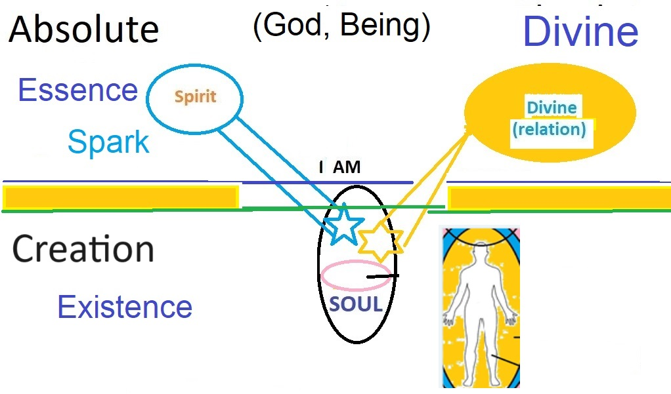
Notes:
We have the Divine Spark as our Eternal Unchanging Essence. We are given a soul and incarnated into a body where we evolve spiritually over many lifetimes. This “Person” , psyche, awakens and develops their inner Divine characteristics. This evolution and alignment with the Divine is the process of spirituality.

Slide 15
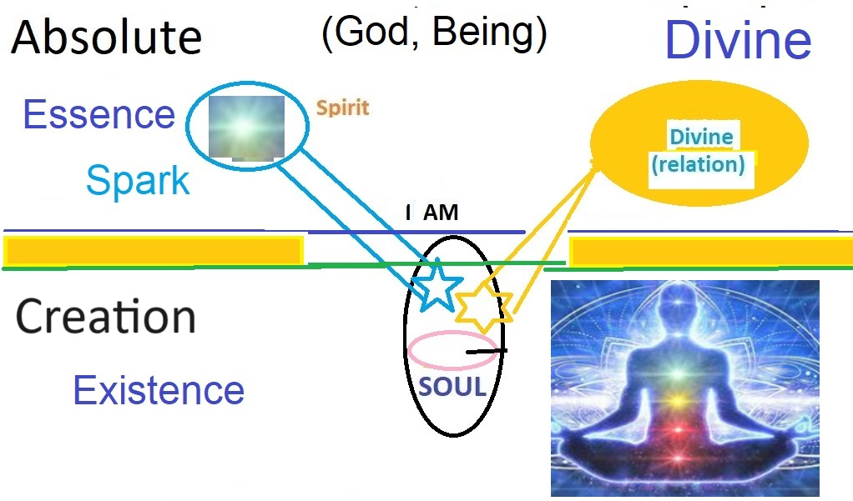
Notes:
In time the Person attains “Wholeness” and is a perfect actualization of the Divine. We pass through many stages of development such Enlightenment, Self-Realization, Cosmic Consciousness, Divine Awareness and Divine Unity. Then their purpose has been fulfilled.
Living Presence quote “Spiritual freedom comes when we develop Soul Consciousness. This happens when the little self intersects with “Infinite Spirit.” This intersection occurs when we practice presence. “

Slide 16
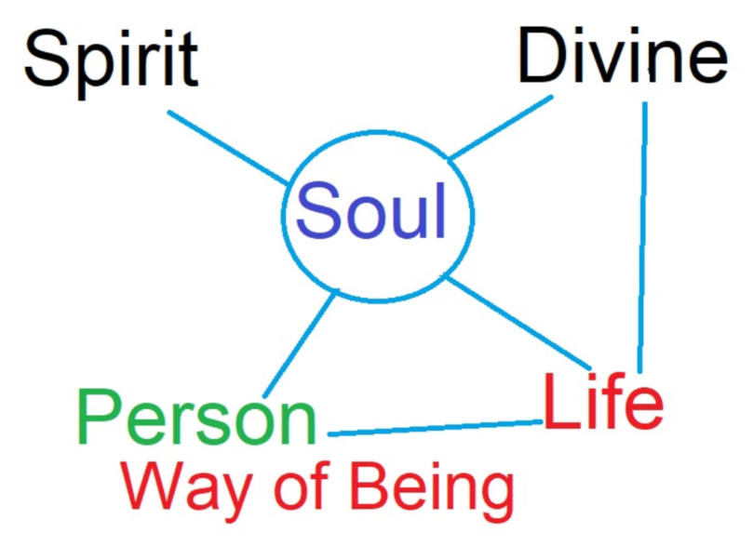
Notes:
Spirituality is awakening to our spiritual essence and the intention to live from Spirit.

Slide 17
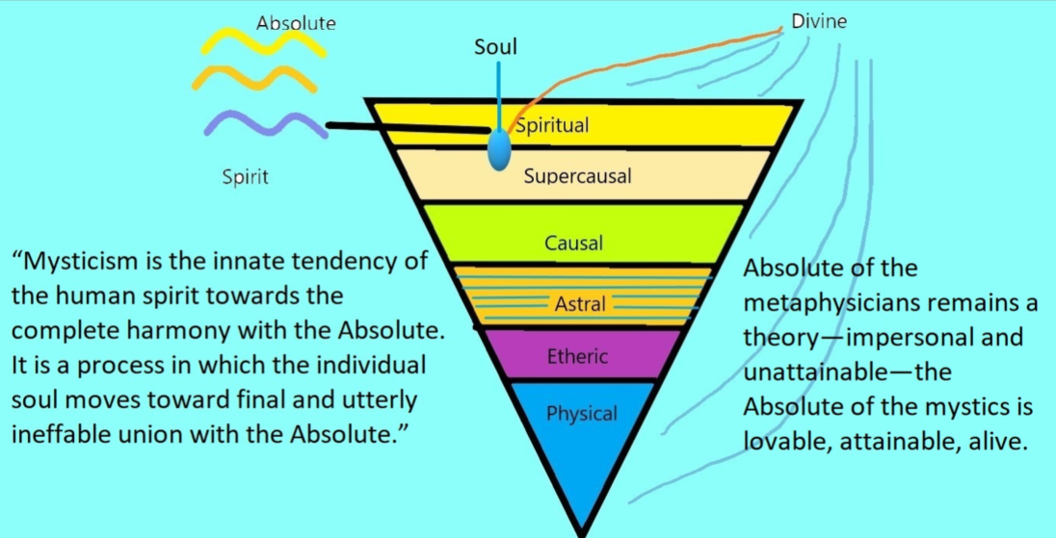
17
Notes:
all beings are on a path back to realizing their original, divine nature while simultaneously expressing that divinity uniquely in the world of form.

Slide 18
Notes:
Life as Integration: The ultimate purpose of life within this framework is to integrate the divine aspects of our transcendental nature with our personal being — comprised of mind, body, and spirit. This means aligning our thoughts, actions, and experiences with the higher truths of our divine essence. The purpose of creation is to express Love and infinite Creativity. You are cherished for your uniqueness.

Slide 19
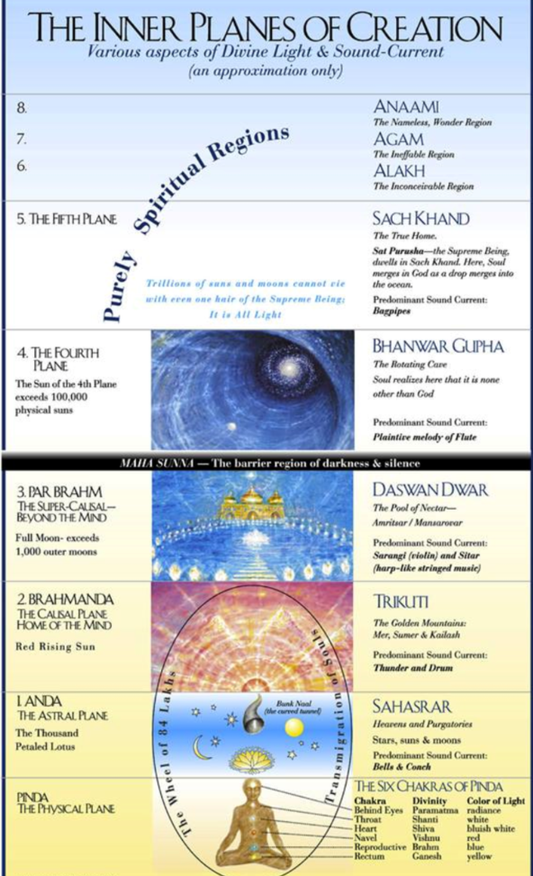

Slide 20
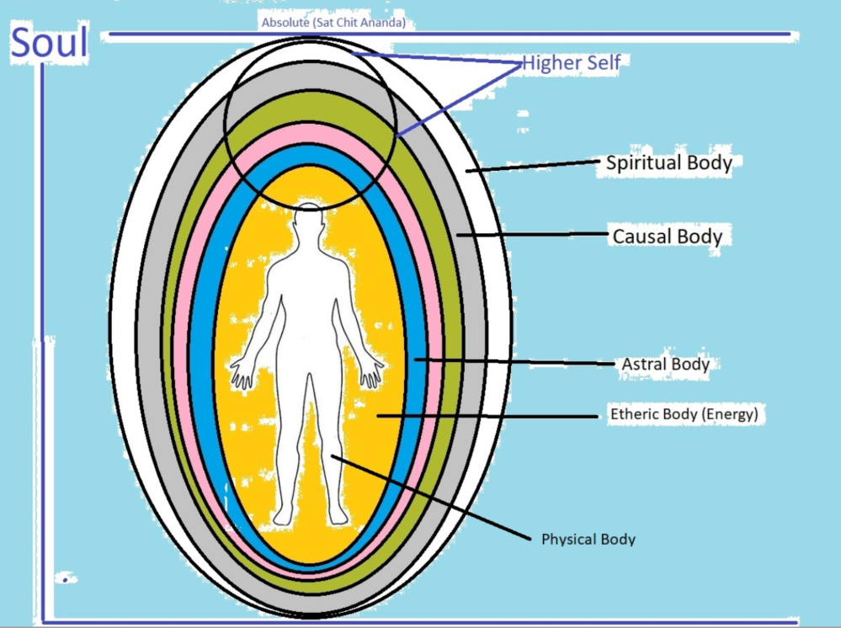
Notes:
As we enter creation, we descend through spiritual planes, each plane wraps the soul in another spiritual body until we enter the physical body. Each of these can are dropped at some point in our return to the Divine Source. (We have Astral and a Causal bodies…)

Slide 21
This Map of the Soul can be seen as an amalgamation of many spiritual and metaphysical beliefs that concern the nature of the Self, the soul, and its relationship to the Divine. It integrates concepts found in various esoteric teachings, reincarnation theories, and transpersonal psychology. Here's an introductory look at this worldview:
Divine Spark as Transcendental Reality: Within this view, the "divine spark" is the core of your being, an indestructible and eternal aspect that is fundamentally one with the Divine source. This spark is transcendental, meaning it exists beyond the physical and temporal realms. It's the purest form of your existence that remains constant across all forms and lifetimes.
Soul as the Spiritual Body: As the divine spark enters creation, it is encapsulated within a soul, which is viewed as a distinct creation by the Divine, designed to house the spark within the manifest world. This soul is not just a repository of experiences, but a dynamic, evolving spiritual entity. It’s considered to be the vehicle through which the divine spark engages with the material world.
Notes:
Outline of the Map of the Soul’s Journey

Slide 22
Soul’s Multidimensional Nature: The soul contains various layers of consciousness. The conscious mind is what we are aware of in our day-to-day life. The subconscious holds our deeper instincts, memories, and learned behaviors. The superconscious is often equated with the higher self or the aspect of our consciousness that is most directly connected to the divine spark and can access universal truths and wisdom.
Reincarnation and the Accumulation of Experience: The soul, in its spiritual journey, incarnates across multiple lifetimes. Each life (lifetime) is an opportunity to learn, grow, and evolve, with lessons and experiences recorded within the soul’s memory — sometimes referred to as the Akashic records in theosophical beliefs. We find our deepest unique expression into the Divine Creation as we awaken and evolve.
Life as Integration: The ultimate purpose of life within this framework is to integrate the divine aspects of our transcendental nature with our personal being — comprised of mind, body, and spirit. This means aligning our thoughts, actions, and experiences with the higher truths of our divine essence. This is the process of Spirituality.

Slide 23
Spiritual Practices: Various spiritual practices, such as meditation, prayer, contemplation, and ethical living, are often recommended within this framework as means to facilitate this integration. Through these practices, individuals may become more attuned to their divine spark and superconscious mind, allowing for greater expression of their inherent divinity in everyday life.
Enlightenment or Self-Realization: The process of integration is accomplished in many stages which are states of consciousness such as enlightenment, self-realization, and God-realization. In time, the individual soul fully recognizes its unique relationship with and later its unity with the Divine and lives out this truth, manifesting the qualities of Sat-Chit-Ananda (being, consciousness, bliss) in human form.
Personal Uniqueness within Universal Oneness: Even as the soul strives to express its divine nature, it does so with its unique personality and characteristics. This paradox of the universal within the particular forms the basis of many spiritual paths. The idea is not to dissolve individuality but to realize it as an expression of the Divine.
Divine Unity: Awakening continues for a very long time, eventually the Spirit prefects the Soul and attains the Divine Unity from which it all originated.

Slide 24
This conceptual framework is a vast and complex synthesis of spirituality and metaphysics, and different traditions will have their own nuances and emphases. The general theme, however, is a journey of return or remembering — the idea that
all beings are on a path to realizing their original, divine nature while simultaneously expressing that divinity uniquely in the world of form.

Slide 25
I AM
... because of the existence within us of the Divine Spark, every soul is implicitly a “child of the infinite.”
The mystic way must be an awakening to include this spark within the conscious field and make it the principle element around which our personality is (re)arranged
Notes:
I AM is the is the realization of Consciousness. Two quotes from the classic book “Mysticism” by Evelyn Underhill. We should connect with this everyday.

Slide 26
The Higher Self
include this spark within the conscious field; from our innermost depths
where It sustains and guides our normal existence.
Notes:
To be noted: Higher Self The mystic way must therefore be a life, a discipline, which will so alter the constituents of our mental life as to include this spark within the conscious field; bring it out of the hiddenness, from those deep levels where it sustains and guides our normal existence, and make it the dominant element round which our personality is arranged.
It is clear that under ordinary conditions, and save for sudden gusts of "Transcendental Feeling" induced by some saving madness such as Religion, Art, or Love,
the superficial self knows nothing of this silent watcher--this "Dweller in the Innermost"--
AND by a deliberate inattention to the messages of the everyday mind, and by the practice of contemplation, the mystic can bring the ground of the soul, the seat of "Transcendental Feeling," within the area of consciousness: making it amenable to the activity of the will.
HIGHER SELF is the Divine Spark within our Soul
include this spark within the conscious field; from our innermost depths
where It sustains and guides our normal existence.
Higher Self always operates from Love, Wisdom and Divine Creativity.
It directs our lives, holds our values, purpose and experiences All of Us.

Slide 27
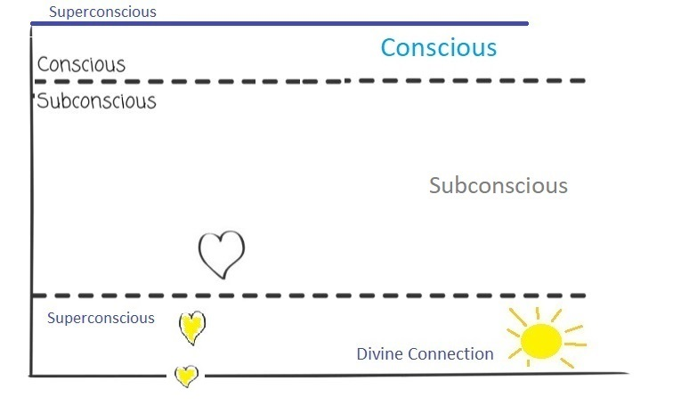
Notes:
Our psyche has parts that are conscious, subconscious and superconscious. Most impulses that manifest as a thought, expression, insight or perception, begin as subtle (but powerful) sparks that originate in the deepest part of our soul, the Superconscious (our connection with Being). It rises through the subconscious taking form as it rises to our conscious awareness. Most impulses are expressions of our Divine nature and personality. Most impulses are Positive in their origination. (negative impulses are explained in the following)

Slide 28
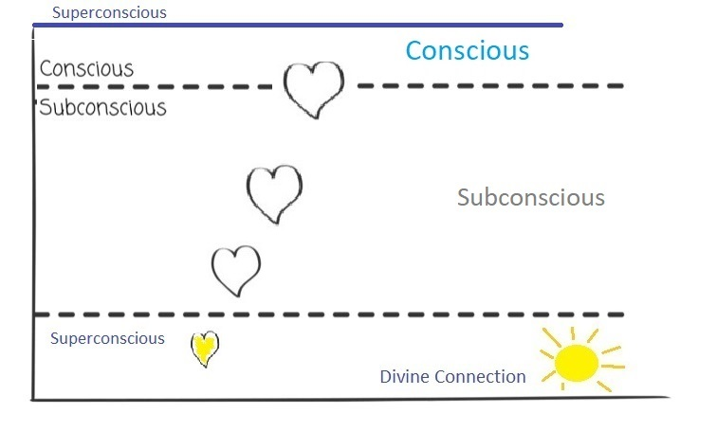
Notes:
Our psyche has parts that are conscious, subconscious and superconscious. Most impulses that manifest as a thought, expression, insight or perception, begin as subtle (but powerful) sparks that originate in the deepest part of our soul, the Superconscious (our connection with Being). It rises through the subconscious taking form as it rises to our conscious awareness. Most impulses are expressions of our Divine nature and personality. Most impulses are Positive in their origination. (negative impulses are explained in the following)

Slide 29
Notes:
As we have meaningful experiences our consciousness expands and some of the subconscious is made conscious. If we could absorb enough evolving experiences, we would come to Full Awakening, Self-Realization and even higher states of consciousness. But this would take many lifetimes to acquire. So the purpose of this system is to accelerate the Soul’s evolution as rapidly as possible. Meditation, Presence and Loving Compassion are the keys to rapid evolution.

Slide 30
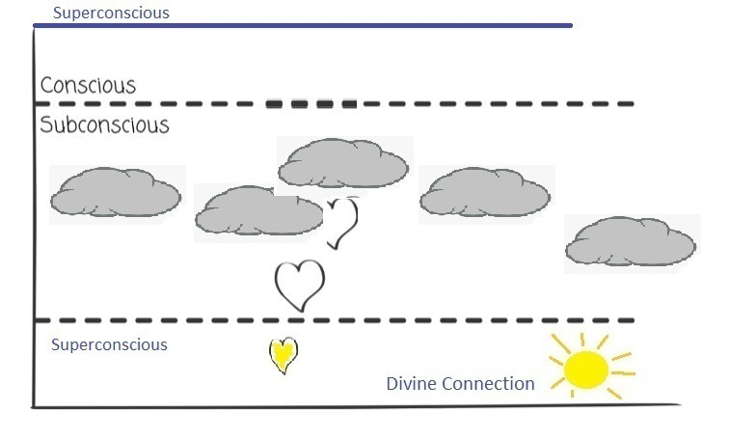
Notes:
However, the process is not that easy. The normal subconscious is filled with clouds of energy that block or shape these impulses and prevent them from reaching our conscious mind in the pure form of the original impulse. (Most impulses begin with a positive intention,, expressing our inner nature, as thought, expression, or as a creative motivation or insight)

Slide 31
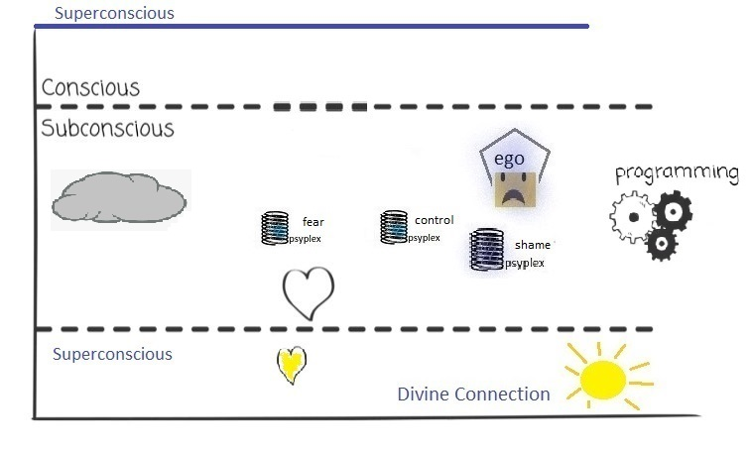
Notes:
The subconscious is filled with these inner energies (vortexes) created from our experiences, they have a large part in shaping our personality and our perception of life. Some of these are dark energies or a spiritual wound, complex, habit, misconception or fear created from powerful life experience and / or repeating patterns. This is like a minefield for the soul’s impulses (creative sparks).

Slide 32
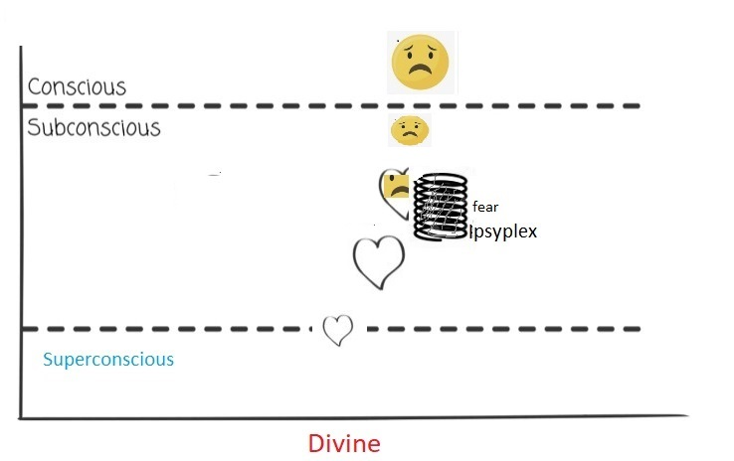
Notes:
Our soul impulses have little chance of rising to consciousness unchanged. For example, a deep impulse of loving expression, perhaps to say “I love you” is beautiful and powerful in its origin, but a subconscious psyplex based on fear hijacks the impulse. The fear is that perhaps the person won’t respond positively to this expression of love. We fear rejection, or humiliation in expressing our true feeling. So, the “fear” mutates the impulse, perhaps into a question “how do you feel about our relation” , or it may completely suppress the expression. When this happens the psyplex is reinforced, becomes more powerful and a greater influence. What we express then is not from our True Self, but from our reactionary defensive egoic self that operates on fear developing our self-view in habits and survival patterns. Psyplexes only survive by absorbing energy and attention from our impulses.

Slide 33
Notes:
Our soul impulses have little chance of rising to consciousness unchanged. For example, a deep impulse of loving expression, perhaps to say “I love you” is beautiful and powerful in its origin, but a subconscious psyplex based on fear hijacks the impulse. The fear is that perhaps the person won’t respond positively to this expression of love. We fear rejection, or humiliation in expressing our true feeling. So, the “fear” mutates the impulse, perhaps into a question “how do you feel about our relation” , or it may completely suppress the expression. When this happens the psyplex is reinforced, becomes more powerful and a greater influence. What we express then is not from our True Self, but from our reactionary defensive egoic self that operates on fear developing our self-view in habits and survival patterns. Psyplexes only survive by absorbing energy and attention from our impulses.

Slide 34
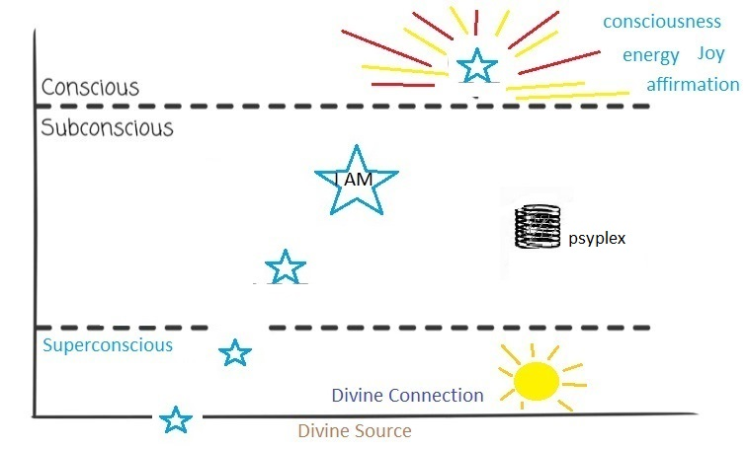
Notes:
In our best moments, a soul impulse rises unobstructed into our consciousness. The original impulses are very powerful and reflect our True Nature, they are compressed creative impulses of our Divine nature. When these reach our conscious, they have the effect of revealing consciousness, joy, affirmation, and positive energy to our psyche. These moments are experienced as “clarity” and direct perceptions. Hi-jacked impulses reach the mind as filtered interpretations and modify our perception of life and our feelings within it.

Slide 35
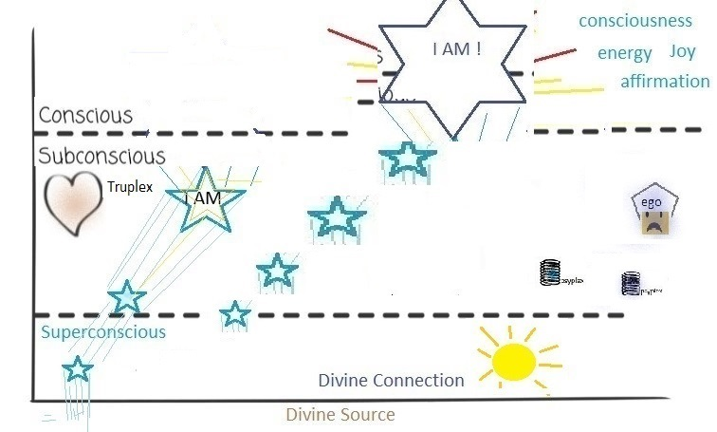
Notes:
There is a bright side to our subconscious also. We also have positive inner resources. Truplexes - a subconscious energy entity that is based on characteristics of our True Self such as Love, Being, Joy, Purposefulness (in the Divine Plan) Integrity, Wisdom. These are nurtured and cultivated in our spiritual awakening. So a walk in the forest with someone we love will resonate deeply within us. The Truplexes of Love and Sense of Being are reinforced and revealed in the experience. The spiritual path can be seen as the cultivation of Truplexes and the dissipation of our psyplexes. Truplexes are characteristics of our Divine nature.

Slide 36
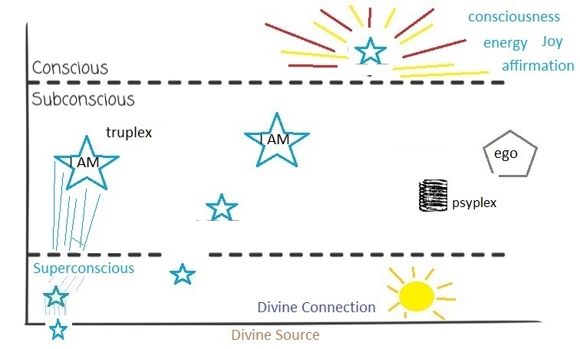
Notes:
So this is a most important point: Truplexes are expressions of our True Divine Nature. They are aspects of our Higher Self, characteristic of the Authentic Self. They are actualizations of our true nature coming into our evolving Person and personality. Psyplexes, on the other hand, have no foundation in Reality. They are created from experience and will (in time) be dissipated by the Light of the Spirit. Shadows disappear in the Light.

Slide 37
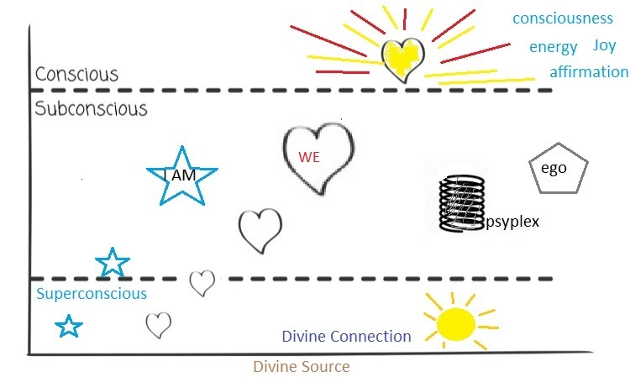
Notes:
So our evolution, spiritual awakening is mostly about dissolving the psyplexes and discovering and nurturing our Truplexes. We become increasingly in harmony with the Divine Plan in this process of personal growth and awakening.

Slide 38
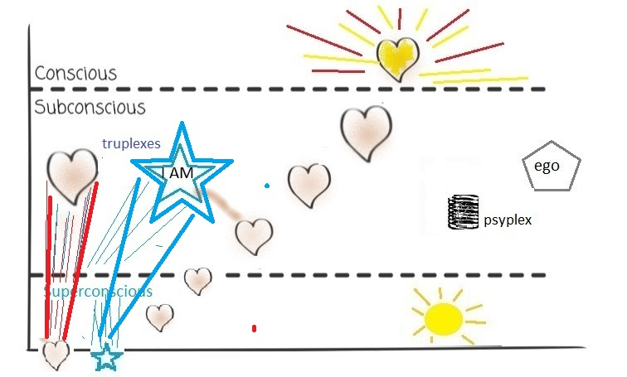
Notes:
Here we see the Truplexes of Love and Being are energized and affirmed by a positive experience. Truplexes are revelations of our inner Light. Psyplexes are shadow entities and can not stand in the Light of the Divine. In time, all psyplexes are dissipated. The ego is a combination of psyplexes with which we identify as our self (lower case s). This is a mistaken identification of self. Enlightenment does not add anything, it is simply a correction in our identity. The absence of the domination of psyplexes is experienced as Clarity.

Slide 39
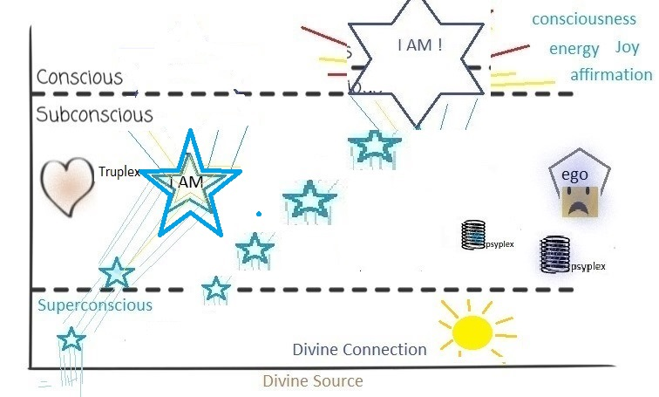
Notes:
As we Awaken (awakening is a never-ending process). Every positive experience or insight connects with a Truplex and expands it. We occasionally have an experience that is so powerful that is an Enlightening transformation, a major step in our spiritual evolution. One day a deeper sense of Being (for example) arises in us ], an illuminating “I AM” . This is such a powerful affirmation of one of our Truplexes that .. (next slide)

Slide 40
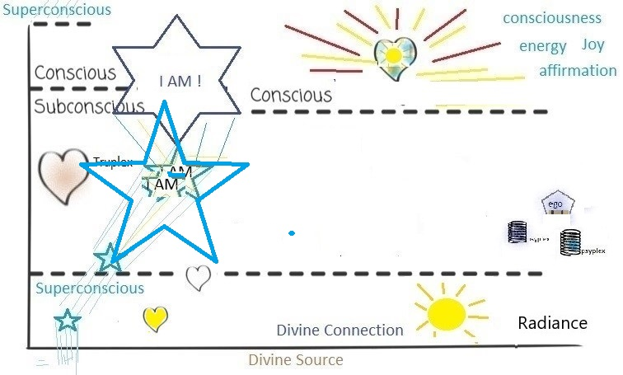
Notes:
This profound “I AM” experience expands our Truplex(es) so that it bridges between the conscious and the superconscious and reveals the truth “I AM” .. In this instant, we have Self-Realization, which connects the conscious, subconscious and superconscious with our Eternal Nature (Divine Spark), and from that moment we have the inner “knowing” of that aspects of our being. We have not changed our essence, but we have liberated our soul’s identification with the ego (egoic mind) and we have found our correct identity with this Higher Self. Our spiritual nature has become actualized in the Person. In this, we will now rebuild our personality around the True Nature of Divine Being. Our experience, perception and expression are all lifted to this new state of consciousness.

Slide 41
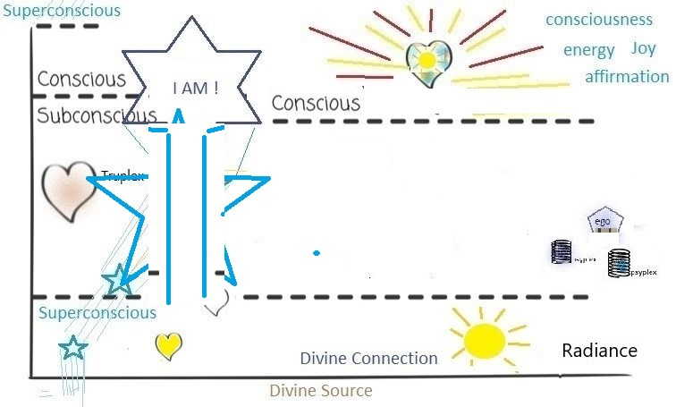
Notes:
This can be experienced as a sudden Clarity when we see directly into the depths of our soul., revealing the Higher Self. The clouds of the subconscious are parted, and the inner light is revealed. There are many enlightenments in our evolution and they lead eventually to Divine Unity.

Slide 42
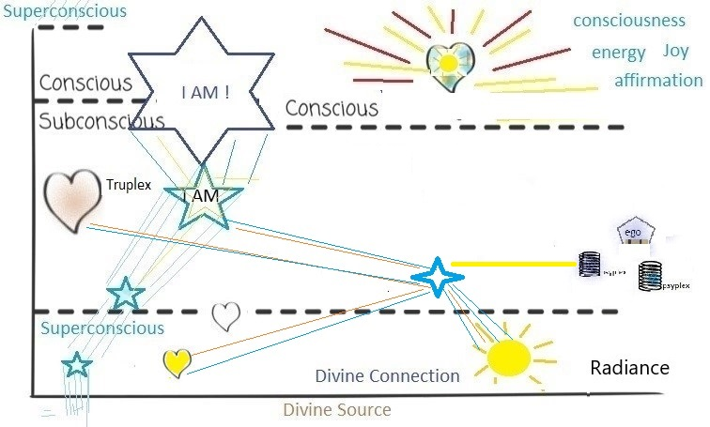
Notes:
Sometimes we have very special impulses (in this case an insight) that reflect the Truplexes and reveal a Truth that corrects some wrong thinking, concept, or way of being. This is called a Miracle. This connects to and is an expression of one or more corresponding psyplexes and this new insight takes place at some moment in our lifetime. Miracles can be cultivated and developed or they may be spontaneous, often triggered by an experience of deep Presence.

Slide 43
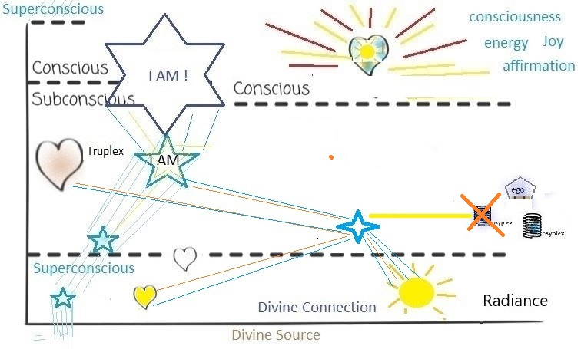
Notes:
The Miracle acts to counter or eliminate a psyplex. (or multiples) ACIM a correction in our perception. A miracle is a gift of transformed perception from the Holy Spirit. When we are willing, the Holy Spirit brings us a change in the way we are thinking

Slide 44
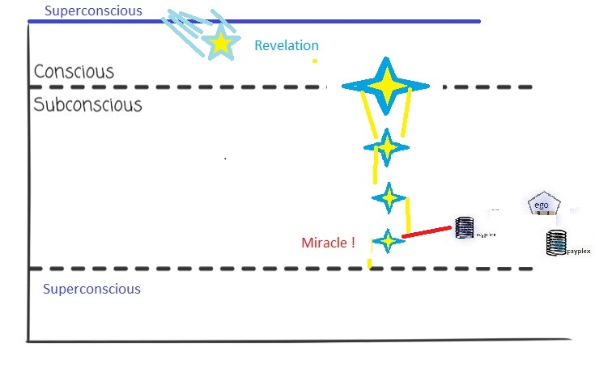
Notes:
We can intentionally and effectively create miracles. This requires a radical surrender transcending our conceptual model of reality. In total surrender we are most receptive to our Higher Self and IT will express itself when thought is transcended. Spiritual Intuition is a key in developing our inner spiritual senses.

Slide 45
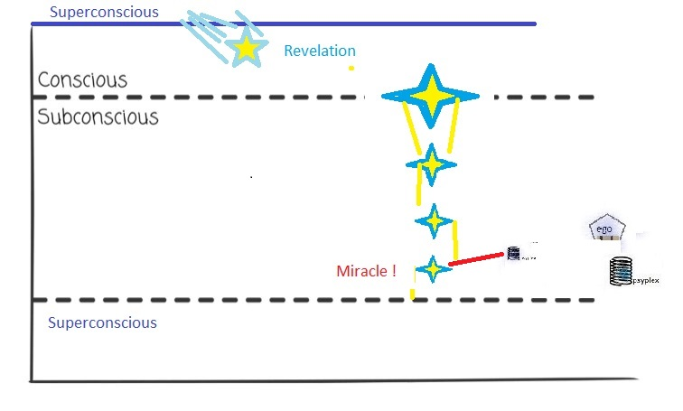
Notes:
Miracles have a sense of Truth and meaning for us. They can be inspiring and even exhilarating to us. They are liberating and grow our ability to express our self with more power and light. A miracle has a profound affect on the soul and changes our perception. Some habit, or karmic pattern that would have taken years or lifetimes to dissipate are eliminated in an instant. This is an upliftment to a higher level. The negative psyplex is “forgiven” and that shading/untruth is released. In that some clarity is attained and our perceptions, sensations, thoughts, beliefs are transformed.

Slide 46
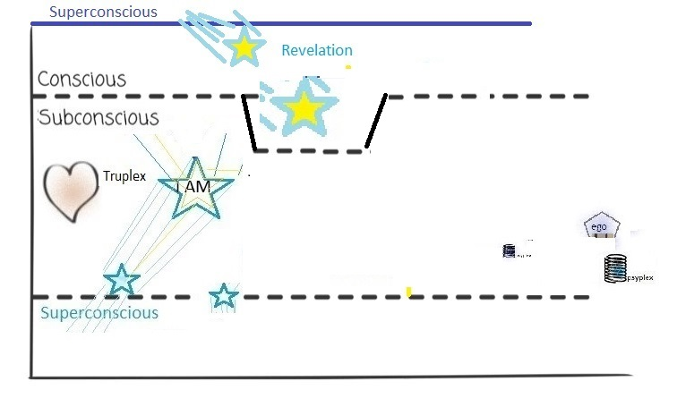
Notes:
A Revelation is a Divine gift. An experience beyond our own attainment. The experience of a Revelation moves us into the Eternal Truth, and we experience a boost, something that is beyond our current state of consciousness; In that timeless moment, our “conscious” is expanded temporarily to support the experience. We know beyond any “knowing”. What remains after the Revelation can vary greatly. It may completely transform us if we take it to heart. It may become just an inspiring memory. It may leave a permanent expansion of consciousness. Our reaction to it is a large part of how we integrate it into our life.

Slide 47
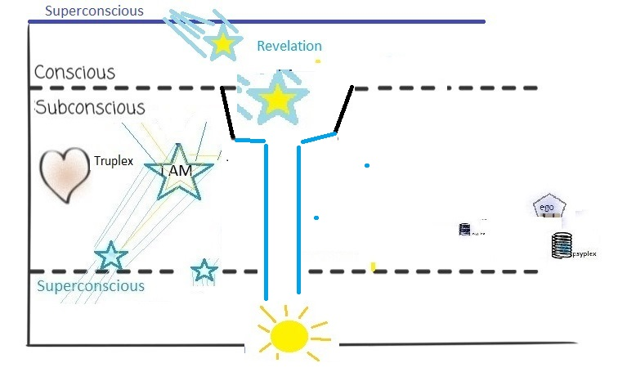
Notes:
The Revelation experience is another but very special “Clarity”. ACIM the greatest "miracle" is the act of simply gaining a full "awareness of love's presence" in a person's life.

Slide 48
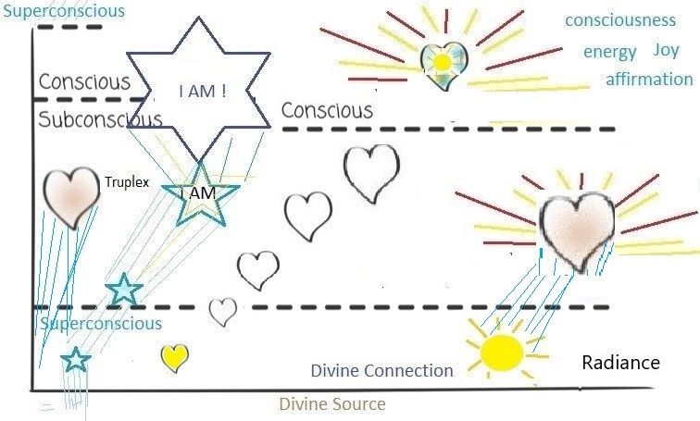
Notes:
When consciousness is expanded and the Truplexes become the dominant sense of our identification, mundane life is transformed into the Radiant Divine Life. At this point we don’t need to deal with any of our negative psyplexes and shadows. Instead, we only need cultivate the Truth. The Light and Love dispels the shadows. WE REALIZE that ARE A REVELATION of the DIVINE in the Divine Creation and then seek to align with the Divine Plan. Spirituality can be seen as the alignment of the Spirit, Soul, Person (body mind complex), the Divine and the Divine Plan. Every question can be answered when we develop spiritual intuition and sense the Divine Plan. Everything is then seen in the Context of the Divine. This is the awakening into Joyous Spirituality .. When everything is seen in the context of the Divine, we know the Divine in every moment. Self-realization, non-duality are steps on the evolution of the soul to Divine-Consciousness and then finally to Divine Unity.

Slide 49
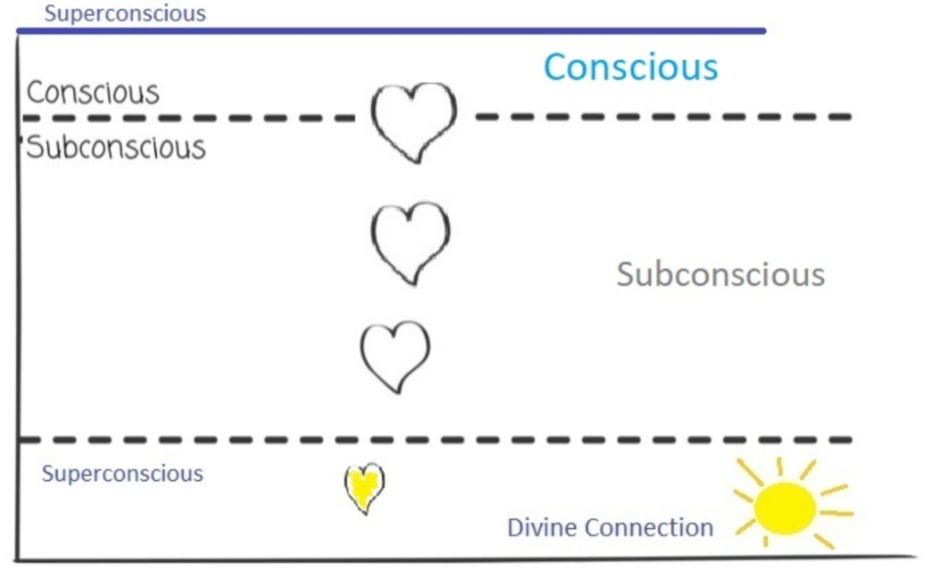
Notes:
Our psyche has parts that are conscious, subconscious and superconscious. Most impulses that manifest as a thought, expression, insight or perception, begin as subtle (but powerful) sparks that originate in the deepest part of our soul, the Superconscious (our connection with Being). It rises through the subconscious taking form as it rises to our conscious awareness. Most impulses are expressions of our Divine nature and personality. Most impulses are Positive in their origination. (negative impulses are explained in the following)

Slide 50
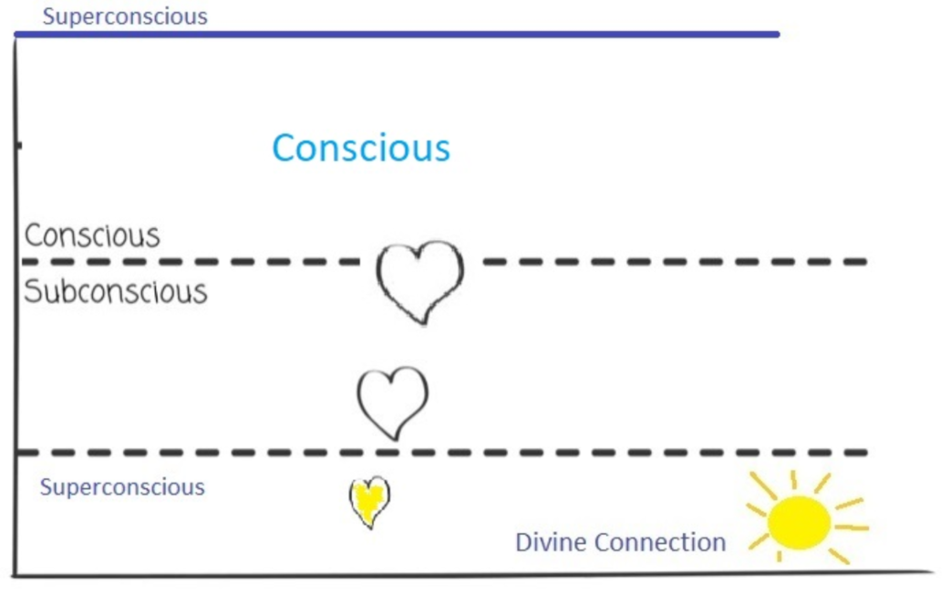
Notes:
As we have meaningful experiences our consciousness expands and some of the subconscious is made conscious. If we could absorb enough evolving experiences, we would come to Full Awakening, Self-Realization and even higher states of consciousness. But this would take many lifetimes to acquire. So the purpose of this system is to accelerate the Soul’s evolution as rapidly as possible. Meditation, Presence and Loving Compassion are the keys to rapid evolution.

Slide 51
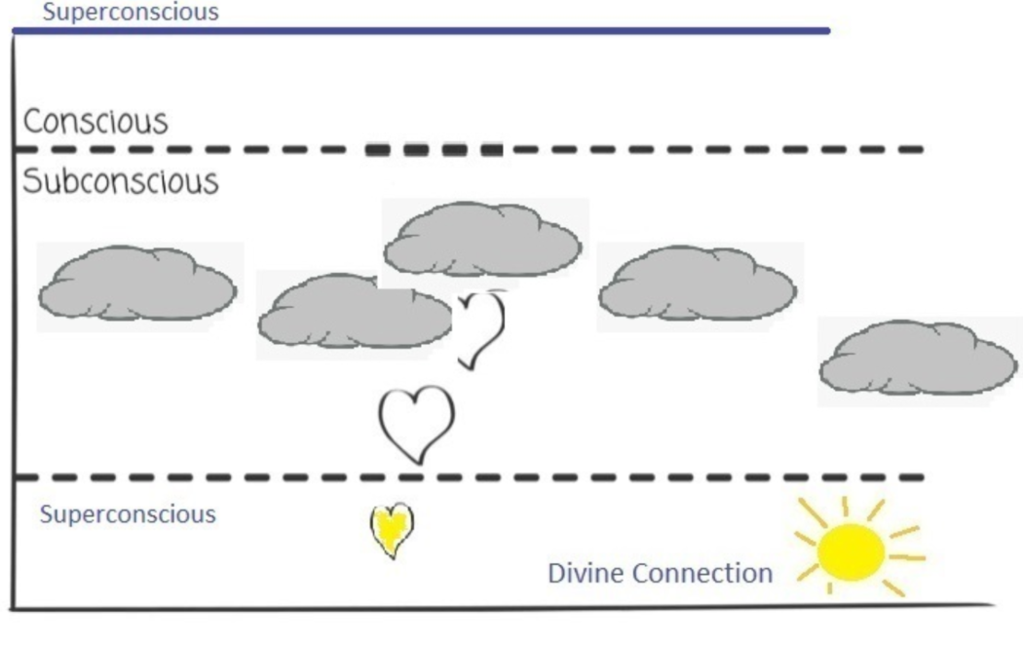
Notes:
However, the process is not that easy. The normal subconscious is filled with clouds of energy that block or shape these impulses and prevent them from reaching our conscious mind in the pure form of the original impulse. (Most impulses begin with a positive intention,, expressing our inner nature, as thought, expression, or as a creative motivation or insight)

Slide 52
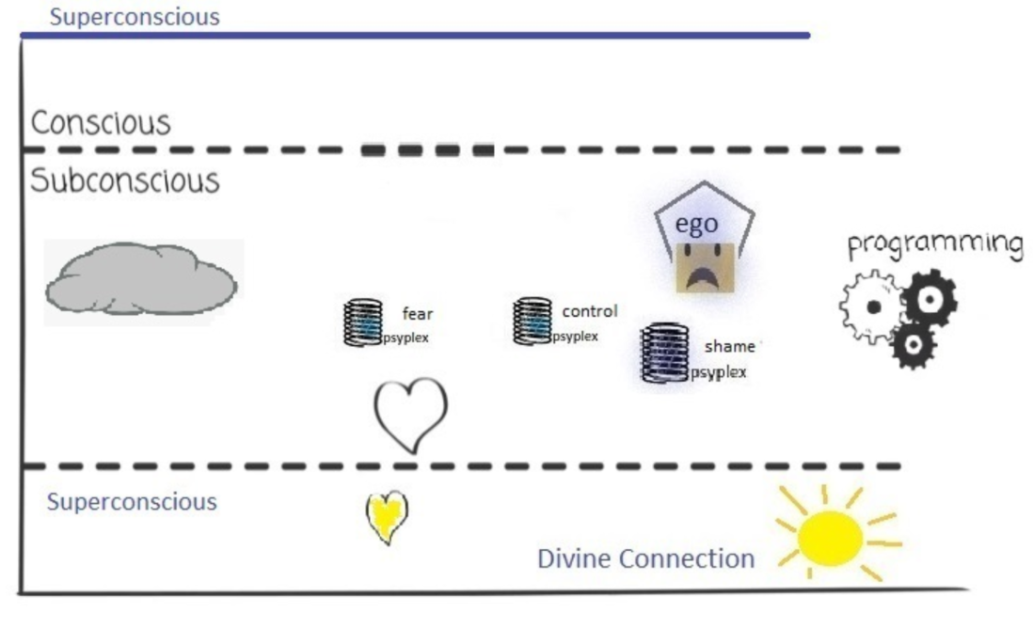
Notes:
The subconscious is filled with these inner energies (vortexes) created from our experiences, they have a large part in shaping our personality and our perception of life. Some of these are dark energies or a spiritual wound, complex, habit, misconception or fear created from powerful life experience and / or repeating patterns. This is like a minefield for the soul’s impulses (creative sparks).

Slide 53
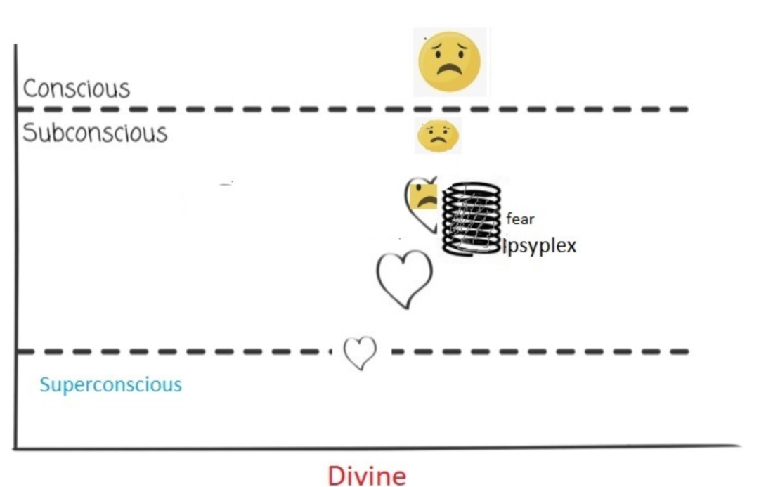
Notes:
Our soul impulses have little chance of rising to consciousness unchanged. For example, a deep impulse of loving expression, perhaps to say “I love you” is beautiful and powerful in its origin, but a subconscious psyplex based on fear hijacks the impulse. The fear is that perhaps the person won’t respond positively to this expression of love. We fear rejection, or humiliation in expressing our true feeling. So, the “fear” mutates the impulse, perhaps into a question “how do you feel about our relation” , or it may completely suppress the expression. When this happens the psyplex is reinforced, becomes more powerful and a greater influence. What we express then is not from our True Self, but from our reactionary defensive egoic self that operates on fear developing our self-view in habits and survival patterns. Psyplexes only survive by absorbing energy and attention from our impulses.

Slide 54
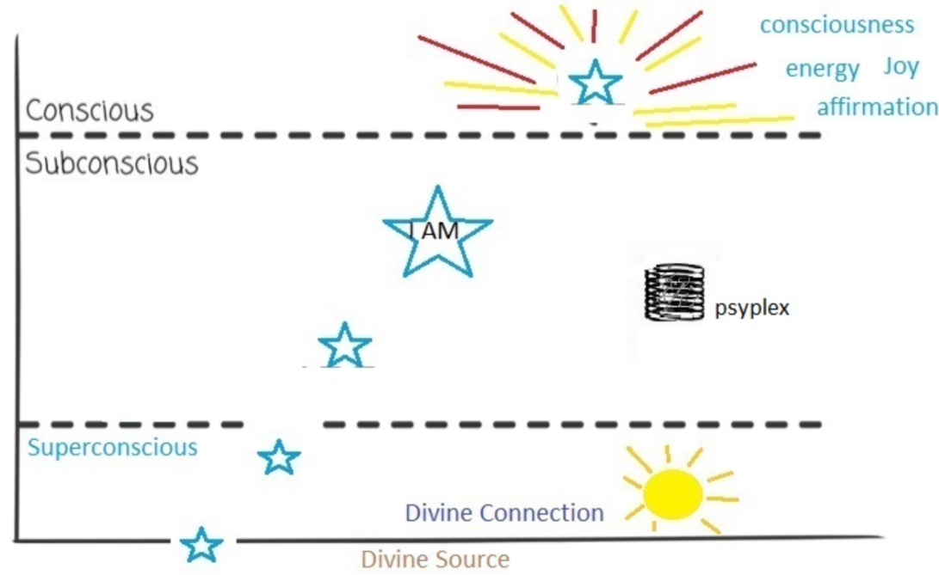
Notes:
In our best moments, a soul impulse rises unobstructed into our consciousness. The original impulses are very powerful and reflect our True Nature, they are compressed creative impulses of our Divine nature. When these reach our conscious, they have the effect of revealing consciousness, joy, affirmation, and positive energy to our psyche. This moments are experienced as “clarity” and direct perceptions. Hi-jacked impulses reach the mind as filtered interpretations and modify our perception of life and our feelings within it.

Slide 55
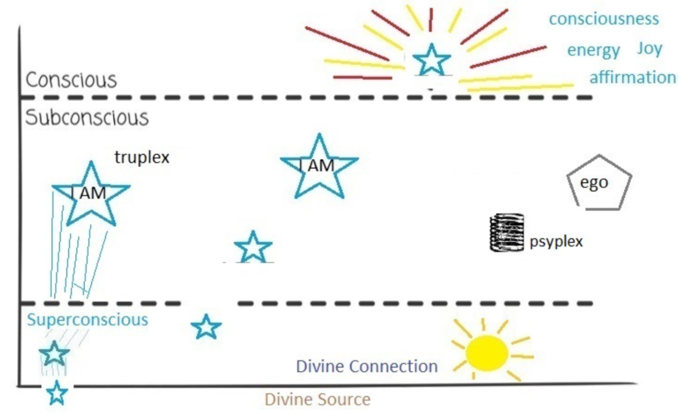
Notes:
There is a bright side to our subconscious also. We also have positive inner resources. Truplexes - a subconscious energy entity that is based on characteristics of our True Self such as Love, Being, Joy, Purposefulness (in the Divine Plan) Integrity, Wisdom. These are nurtured and cultivated in our spiritual awakening. So a walk in the forest with someone we love will resonate deeply within us. The Truplexes of Love and Sense of Being are reinforced and revealed in the experience. The spiritual path can be seen as the cultivation of Truplexes and the dissipation of our psyplexes. Truplexes are characteristics of our Divine nature.

Slide 56
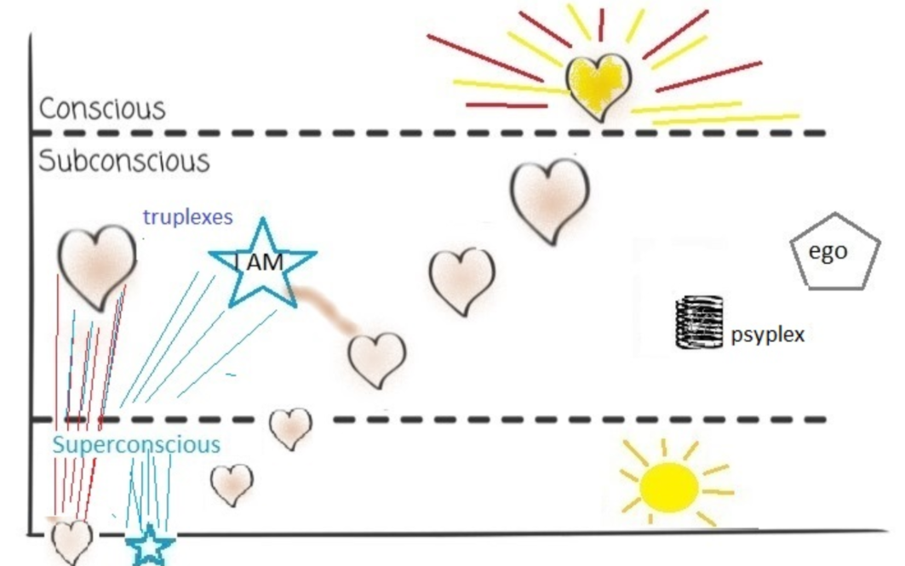
Notes:
So this is a most important point: Truplexes are expressions of our True Divine Nature. They are aspects of our Higher Self, characteristic of the Authentic Self. They are actualizations of our true nature coming into our evolving Person and personality. Psyplexes, on the other hand, have no foundation in Reality. They are created from experience and will (in time) be dissipated by the Light of the Spirit. Shadows disappear in the Light.

Slide 57
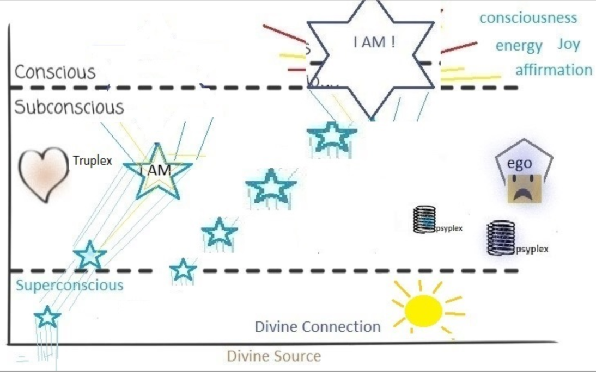

Slide 58
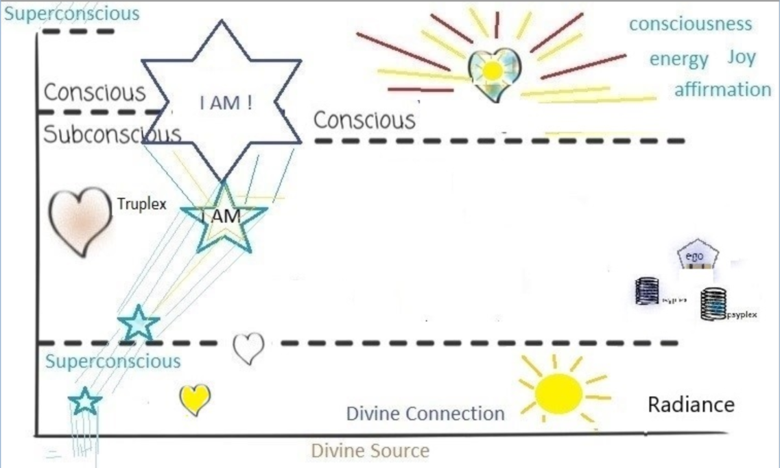

Slide 59
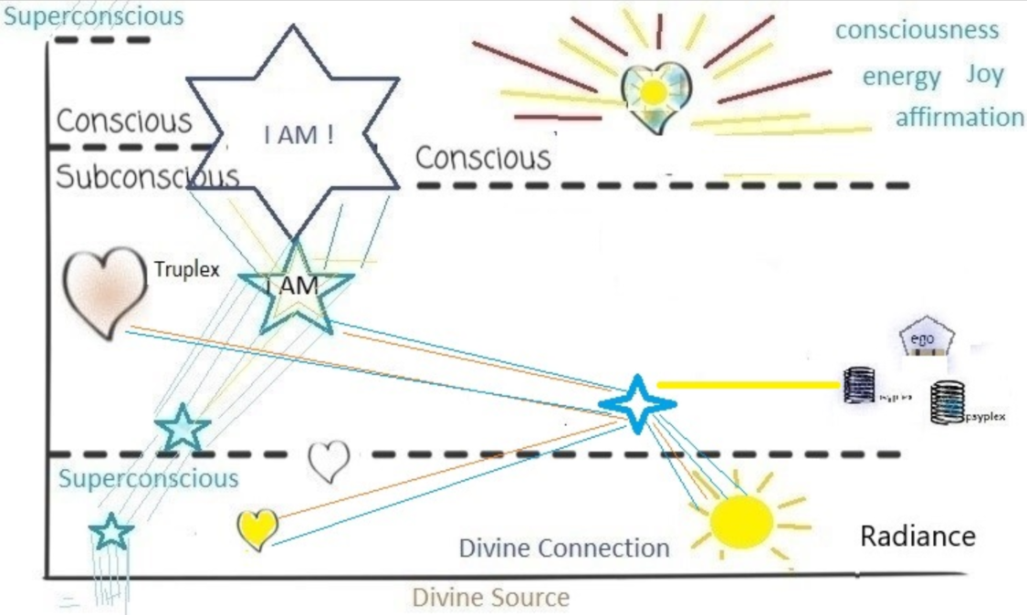

Slide 60
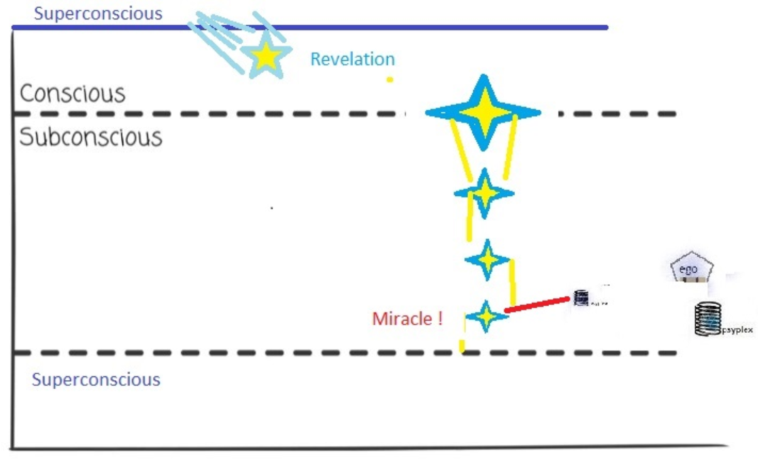

Slide 61
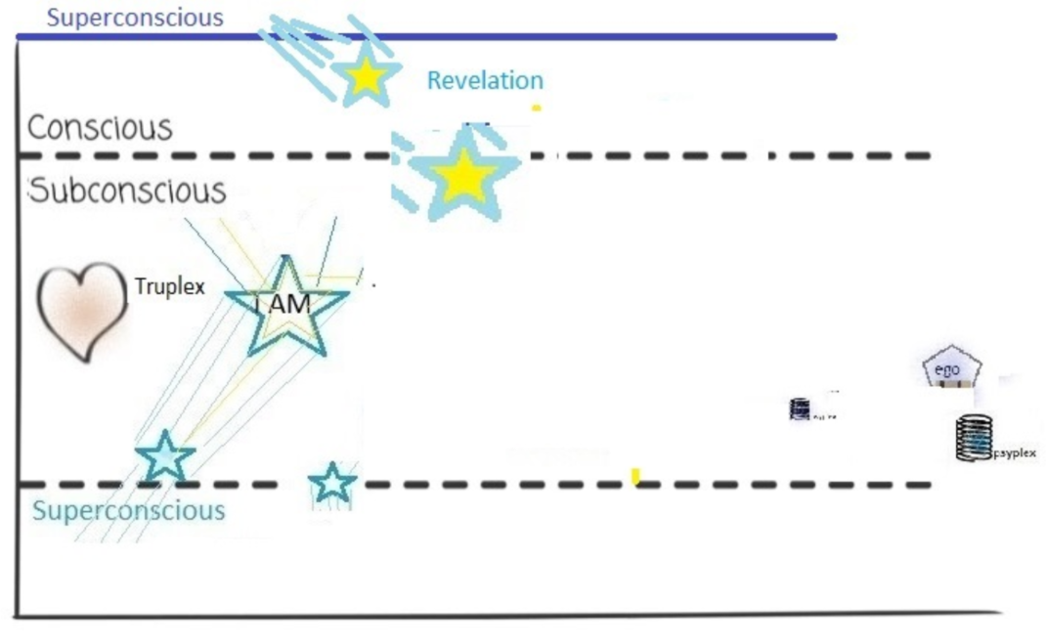

Slide 62
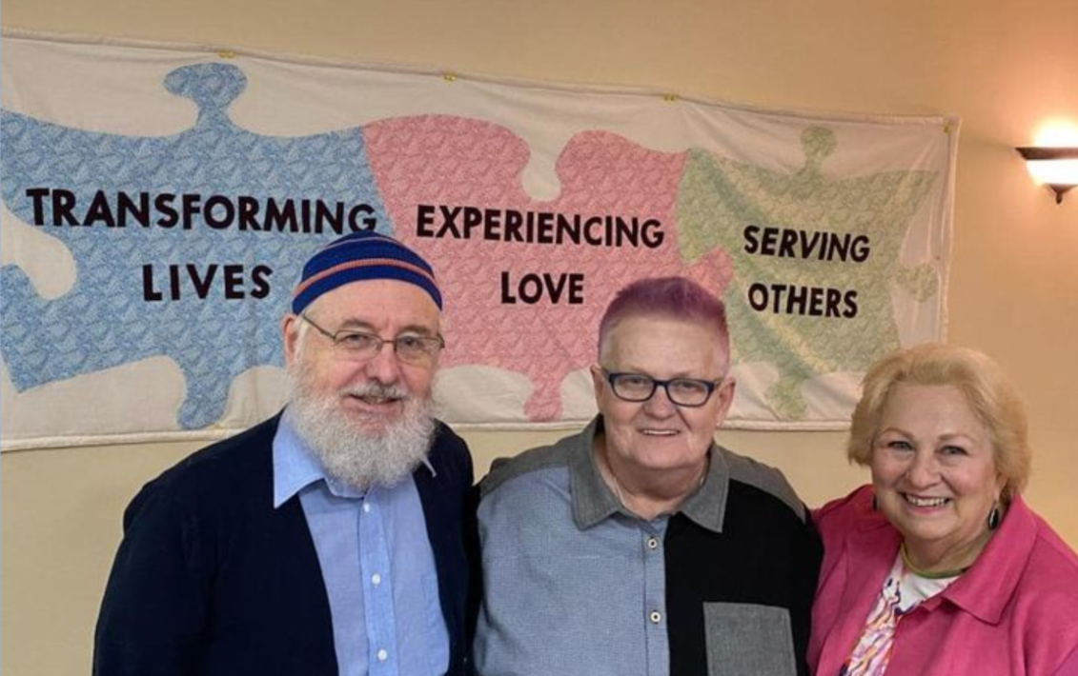
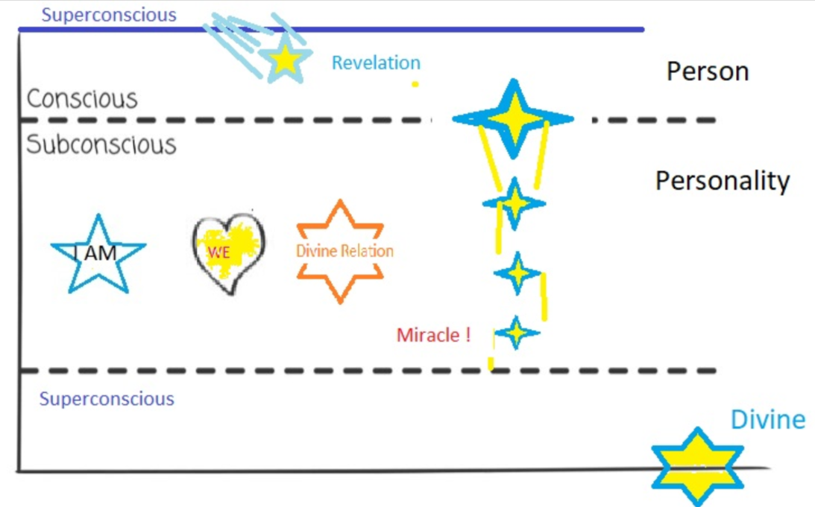

Slide 63
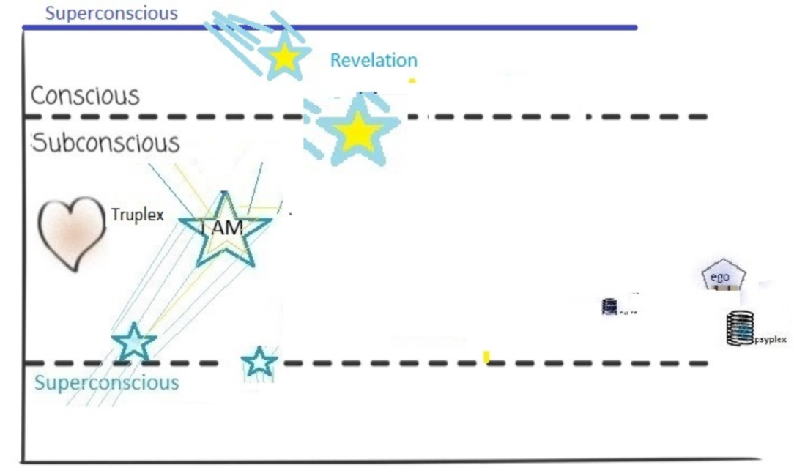
Notes:
So our path opens us to Joy (Bliss) harmony with our True nature, our True Purpose and the Meaning of Life. Love and Joy and Compassion and Creativity are elements of our Divine Nature.

Slide 65
Notes:
Looking at the nature of the Soul, we find the Higher Self is the direct reflection of the Divine Spark and it has a purpose and direction for our life based on the Divine Plan and the values we develop and the Intention that that shapes within our Soul.

Slide 68
Notes:
Our deepest innermost feeling of Identity is actual more related to Our Being (than our egoic – mind) I AM is the essence , the Radiance, the Consciousness of Being.

Slide 73
Notes:
Our Cosmological hologram – contains all knowledge

Slide 82
The Essence of Spirituality
Transcending the ego.
Presence and mindfulness
Practical spiritual exercises
Love and compassion:

Slide 83
The Essence of Spirituality
Personal transformation and growth.
Awakening to one's true nature
Living Presence (Consciousness)
Connection with the Divine
An authentic Way of Living.
Joyous Celebration and Sharing

Slide 84
“Mysticism is the innate tendency of the human spirit towards the complete harmony with, and final union with the Absolute.”
The Absolute of mystics is … lovable, attainable, alive.

Slide 85
I AM
... because of the existence within us of the Divine Spark, every soul is implicitly a “child of the infinite.”
The mystic way must be an awakening to include this spark within the conscious field and make it the principle element around which our personality is arranged

Slide 86
The Five Principles of Unity are:
The five basic principles of Unity are:
1. God is the source and creator of all. There is no other enduring power. God is good and present everywhere.
2. We are spiritual beings, created in God’s image. The spirit of God lives within each person; therefore, all people are inherently good.
3. We create our life experiences through our way of thinking.
4. There is power in affirmative prayer, which we believe increases our connection to God.
5. Knowledge of these spiritual principles is not enough. We must live our spiritual principles.

Slide 87
95% of our daily reactions and evaluations arise from the Subconscious
-our experience is filtered and interpreted by the Subconscious
- our current direction and evolution is determined by the Subconscious
5% - 10% of our experience and expression is conscious

Slide 88
The "poetic mind" that awakens within you,
Is a gateway to realms unseen and true.
It's a state of being where words take flight,
And emotions soar, dancing in divine light.
The poetic mind is a doorway to the sublime,
Where the ordinary becomes extraordinary, in time.
It reveals the wonders of life’s wonderous design,
Unveiling the mystical and the Divine.

Slide 89
Embracing the Journey: From Seekers to Finders on the Spiritual Path
The Nature of the Journey:
II. The Role of Seeking:
III. Becoming Finders:
IV. The Gifts of Becoming Finders:

Slide 90
The Finder is Realized by:
- Reprogramming the subconscious mind requires consistent and focused repetition of positive Truths and affirmations that align with the desired change OR profound experiences, revelations and miracles..
Pick one affirmation and start your day with it and remember often during your day.
Just before sleeping, review the affirmation and consider how effective you were expressing it in your life. If you are satisfied, then go on to the next one.

Slide 91
Here is an affirmation practice that incorporates the five principles of New Thought Unity:
Step 1: "There is only one Presence and one Power active as the Universe and in my life. I am one with the Divine Flow of abundance and love."
Step 2: "My essence is of the Divine; therefore, I am inherently good. I embrace my divine nature and radiate love and goodness to all."
Step 3: "As a co-creator with the Divine, I harness the power of my thoughts to manifest a reality aligned with my highest good. I choose thoughts of joy, abundance, and peace."
Step 4: "Through prayer and meditation, I align my heart-mind with God's infinite wisdom and guidance. I open myself to receive divine inspiration and clarity."
Awareness: “I am not the body. Body will sleep my soul awakens to my spirit rising above the body."

Slide 92
The Mystic Proclamation:
I embrace and affirm the grandeur, beauty, and intensity of the Eternal Reality within me.
My existence radiates the living wonder of this Divine Presence.

Slide 93
“The joy of being is derived not from something that happens, or from some object, but from the essence of who you are,” . “To know yourself as that is joy.”
“The Joy of Being: Awakening to One’s True Identity” Eckhart Tolle
When the practice becomes
part of us …It is our Way of Being

Slide 95
Namaste Greeting

